Slide 1
Career map in IT company. Horizontal / Vertical grows
Yura Havryliv
People Management Course 2015
Notes:
‹#›

Slide 2
Agenda
Levels, Roles
Career Path
Simple structures / complex structures (IBM, Cisco)
Multiple competencies
Matrix company structure (Spotify)
"23 Year Seniors” problem
Mentorship
People Management Course 2015

Slide 3
Levels, Roles
What is level and a role
Tech levels
Management levels
Administrative group
Finance department
People Management Course 2015

Slide 4
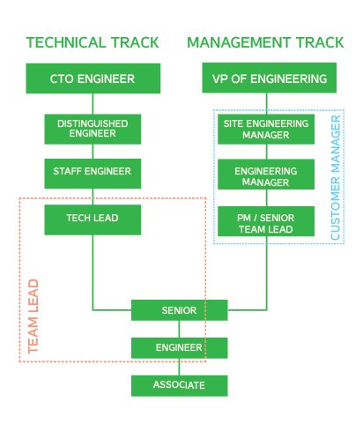
Career path
What is your goal?
Formal and informal promotion
Career Benefits
People Management Course 2015

Slide 5
Simple / complex structures (IBM, Cisco)
Hierarchy
Scale
Managers, bureaucracy
Controlled chaos
People Management Course 2015
Notes:
http://www.bradreese.com/blog/cisco-org-chart-oct-2012.pdf
http://postpaper.com.ua/city/rebbix.html#.VXhHzhOqpTI

Slide 6
Multiple competencies
T-shape engineer
Secondary Skill
Conferences, clubs, groups, communities
People Management Course 2015

Slide 7
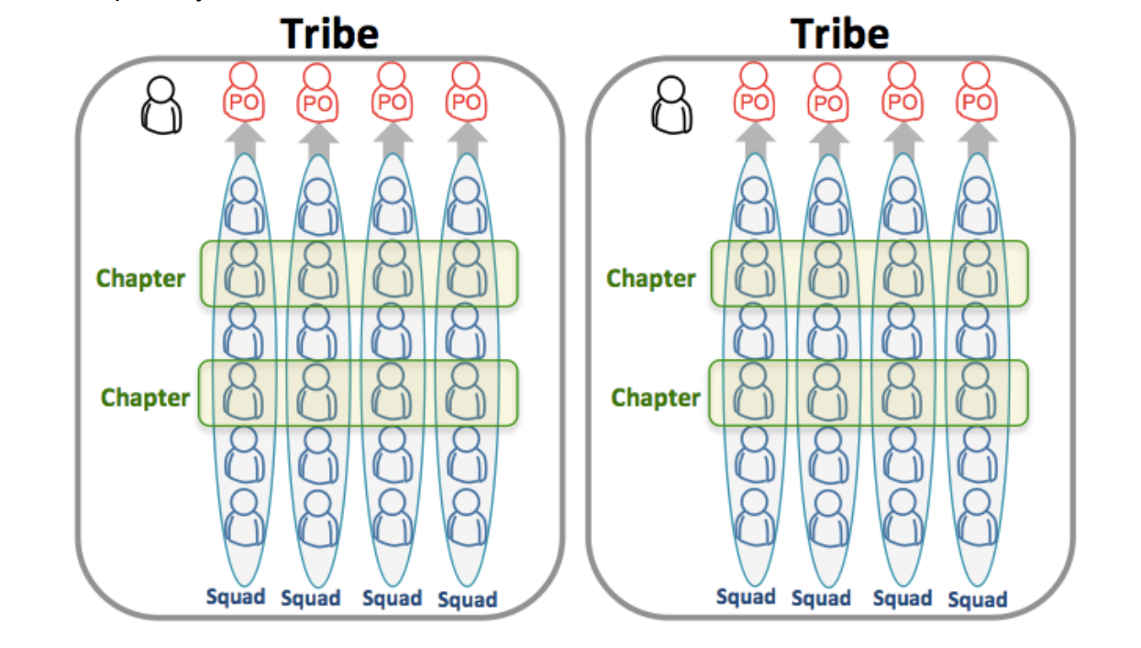
Matrix company structure (Spotify)
Squad
Tribe
Chapter
Guild
How the scaling works?
People Management Course 2015
Notes:
https://dl.dropboxusercontent.com/u/1018963/Articles/SpotifyScaling.pdf

Slide 8
"23 Year Seniors” problem
Rapid grows of the industry
Seniority devaluation
Jumpers(Changing work often)
"Level of incompetence"
People Management Course 2015
Notes:
http://en.wikipedia.org/wiki/Peter_Principle

Slide 9
Mentorship
Teach junior engineers
Share the knowledge
Run the community
People Management Course 2015

